Slide 1
Project Title: Anti-sleep driver alert system
Team ID: 10
Team Members’ Details
Sl.No | Student ID | Student Name | Section | Contact | Email
1. | 2310040085 | D Guru Yeswanth | S2 | 9347246670 | 2310040085@klh.edu.in
2. | 2310040087 | Y Vignesh | S2 | 9381801532 | 2310040087@klh.edu.in
3. | 2310040088 | G Vamshi krishna | S2 | 8500028586 | 2310040088@klh.edu.in
4. | 2310040094 | Koushik Ram | S2 |  | 2310040094@klh.edu.in
5 | 2310040096 | Y Sritej Mokshagna Reddy | S2 | 9492837775 | 2310040096@klh.edu.in

Slide 2
Problem Statement
Drowsy driving is a significant safety issue worldwide, causing numerous road accidents every year. This project aims to reduce the risks associated with driver fatigue by developing an anti-sleep alert system that monitors driver alertness in real-time. The system detects signs of drowsiness and provides timely warnings, which could prevent accidents and save lives.

Slide 3
Project Goals & Objectives
Develop a cost-effective, real-time monitoring system to detect driver drowsiness.
Design a wearable prototype, specifically goggles with a blink sensor, to continuously monitor the driver’s eye movements.
Provide timely alerts to prevent accidents caused by driver fatigue.
Increase road safety by reducing the number of drowsy driving incidents.
Create an easy-to-use solution that can be widely adopted by drivers for enhanced safety.

Slide 4
Primary Stakeholders
Drivers
Role: Primary users of the anti-sleep alert system, providing feedback on functionality, comfort, and effectiveness.
Benefits: Improved safety and reduced risk of accidents due to drowsiness, enhancing overall driving experience and personal security.
Technology and Electronics Suppliers
Role: Supply affordable components (e.g., Arduino kits, sensors) necessary for the prototype and production of the device.
Benefits: Opportunities to showcase the application of their components in impactful safety technology and potentially expand their market.
Drivers, who benefit directly from increased safety.
Fleet operators who manage driver safety, insurance companies interested in reducing claims, regulatory bodies overseeing safety compliance, and maintenance teams for system upkeep.

Slide 5
Community Partners
Automotive Manufacturers or Companies – Automotive companies could be interested in collaborating to integrate the blink sensor system into their vehicles or help with the hardware and technology needed for the goggles.
Technology Companies – Companies specializing in wearable technology, sensors, or safety systems could contribute to the development of the sensor hardware or offer expertise in creating reliable, user-friendly products.
Government Traffic Safety Agencies – Government agencies, like those involved in road safety and public health, could help with regulatory approvals, provide funding or grants, and help in rolling out the system on a wider scale.

Slide 6
Solution Overview
System Components
Goggles with Blink Sensor: Monitors blinking patterns; triggers an alert if prolonged eye closure or slow blinks are detected.
Alert Mechanism: Activates sound (buzzer), vibration, or LED lights on detecting drowsiness.
Working Mechanism
Data Collection: Blink sensor monitors frequency and duration of blinks.
Data Processing: A microcontroller (Arduino uno) processes data to identify drowsiness.
Trigger Alert: Activates alerts to prompt the driver to stay alert or rest.
Technical Specifications
Microcontroller: Manages blink sensor data and alert mechanisms.
Power Supply: Rechargeable battery for portability.
Sensors: IR sensor or photodiode detects eyelid movement without disturbing the driver.
System Integration
Real-time Monitoring: Continuous monitoring ensures instant alert on drowsiness detection.
Community Integration: Partnerships with road safety and tech organizations improve accuracy and reach.
Benefits
Increased Safety: Lowers risk of fatigue-related accidents.
User-Friendly Design: Lightweight, portable goggles.
Customizable Alerts: Adjustable sound, vibration, or light alerts for effective wake-up mechanisms.

Slide 7
Design and Prototyping Process
Identify Requirements (5 Days)
Conceptual Design
(1-1.5 Week)
Component Design
(3 Days)
System Architecture (6 Days)
Prototyping Phase (3 Weeks)
Testing (1 Week)
Final Documentation (5 Days)

Slide 8
Roles and Responsibilities
Prototype Making
Topic Research
Koushik Ram
Component Collection
Sritej Mokshagna
Testing
Vamshi krishna
Guru Yeswanth ,Vignesh

Slide 9
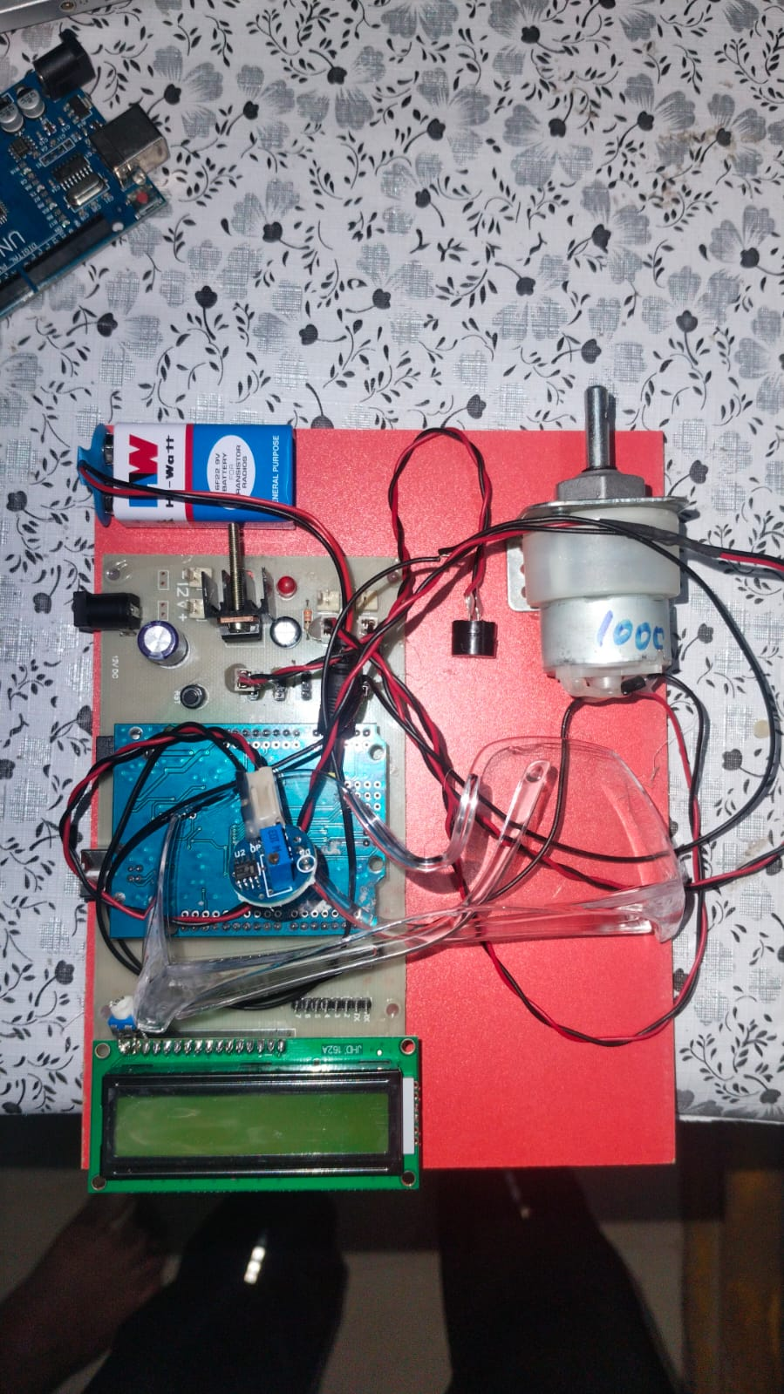
Budget and Resources:
S.No | Item Name | Quantity | Price
1. | Arduino Uno | 1 | ₹ 400.00
2. | Eye blink sensor with goggles | 1 | ₹ 300.00
3. | Power Supply | 1 | ₹25.00
4. | Lcd display | 1 | ₹100.00
5. | Dc motor | 1 | ₹ 100.00
6. | Buzzer Alarm | 1 | ₹20.00
7. | Connecting wires | As many as required | ₹20.00
8.TOTAL COST |  |  | ₹965.00
*We have also used Arduino IDE software for compiling the code

Slide 10
Prototype Demonstration
Title: Prototype Demonstration
Content: Show images or videos of your final prototype in action. Highlight any key features or functionalities.
Must provide : Brief description or list of improvements made during testing.

Slide 11
Testing and Results
Testing
Sensor Accuracy Testing: Verified that the blink sensor accurately detects eyelid movements and differentiates between normal and drowsy blinks. This can involve simulated drowsiness and intentional prolonged eye closures.
Alert Mechanism Testing: Checked that the alerts (buzzer, LED, or vibration) activate correctly when drowsiness is detected and are effective at alerting the user without delay.
Battery and Durability Testing: Measured battery life under continuous operation and assess durability of the goggles during prolonged use.
2. Results
High Detection Accuracy: The system reliably detect drowsy blinks with a detection accuracy above 99%, minimizing false positives and negatives.
Immediate Alert Activation: Alerts activated within a second of detecting drowsiness, effectively notifying the driver in real-time.
User Satisfaction: Drivers found the goggles comfortable and the alerts effective without causing discomfort or distraction.
Adequate Battery Life: The device should run continuously for at least 6-8 hours on a full charge.

Slide 12
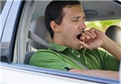
Community Impact of Anti-sleep driver alert System
The anti-sleep driver alert system can have a strong community impact by:
Enhancing Road Safety: Reducing fatigue-related accidents and raising awareness about drowsy driving.
Supporting Commercial Drivers: Helping long-haul drivers stay alert, thus protecting passengers and improving company reputation.
Promoting Public Health: Encouraging better sleep habits and educating about the dangers of sleep deprivation.
Reducing Economic Costs: Saving on healthcare and repair costs due to fewer accidents.
Enabling Partnerships: Collaborating with safety organizations and tech companies to promote safe driving.

Slide 13
Future Integration Ideas
Integration with Vehicle Systems: Connect the system with vehicle controls to automatically adjust settings like slowing down or activating hazard lights if drowsiness is detected.
Data Logging and Analysis: Enable the system to log blink and alert data, allowing drivers to review their alert history and track patterns of fatigue over time.
Mobile App Connectivity: Use a companion app to notify family members or fleet managers if the driver shows frequent drowsiness or provide GPS location alerts.
AI-Powered Personalization: Incorporate AI to learn the driver’s specific blink and sleep patterns, offering more accurate detection tailored to the individual.
Adaptive Alert Systems: Develop adaptive alerts that intensify if drowsiness continues, starting with gentle reminders and escalating to louder sounds or more intense vibrations.
Voice-Activated Alerts: Use voice-activated technology to allow the driver to respond to alerts or initiate rest reminders.

Slide 14


